Slide 1
美國文學史
陳信智

Slide 2
This course aims to help students have a basic understanding of American literature through key historical events and cultural trends. Students are expected to familiarize themselves with essential cultural knowledge after they finish this course.
課程主旨在透過文學史的角度來認識美國歷史與文化

Slide 6
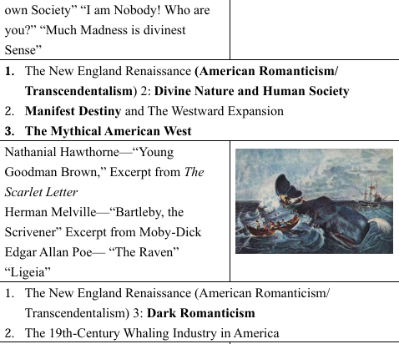

Slide 7
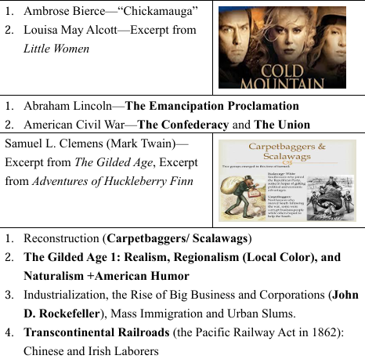

Slide 8
