Slide 1
English Reading (1)
Tsai. Chih-Hung Department of Foreign Languages & Literature
The Open University of Kaohsiung

Slide 2
Course Objectives
Knowledge & Cognitive Domain: Help learners acquire a general understanding of various real-life events
(2) Skill Domain: Empower learners with competency-oriented English reading skills
(3) Affective Domain: Promote learners’ overall interest & motivation in learning English

Slide 3
Unit 1: Greetings Around the World
* Have you ever made any friends from other countries?
* What are some of the different ways people in other countries greet each other?
*How would you feel if someone kissed you on the cheek when you first met? What if the person showed you his or her tongue?

Slide 4
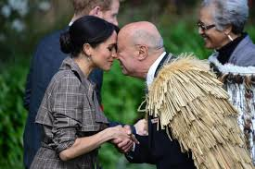
Maori Hongi

Slide 5
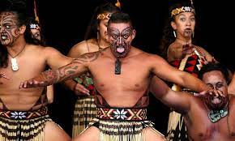
Maori Haka

Slide 6
Unit 6: Environmental Conservation: Making money from wasted food – P. 66
*What do you think the worst environmental problems
today?
*Do you think people do enough cycling? What type of recycling do you do?
*What do you think the world’s environment will be like in 50 years?

Slide 7
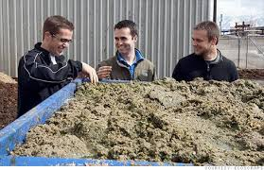
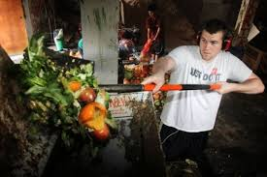
Recycling Food Waste

